Slide 1
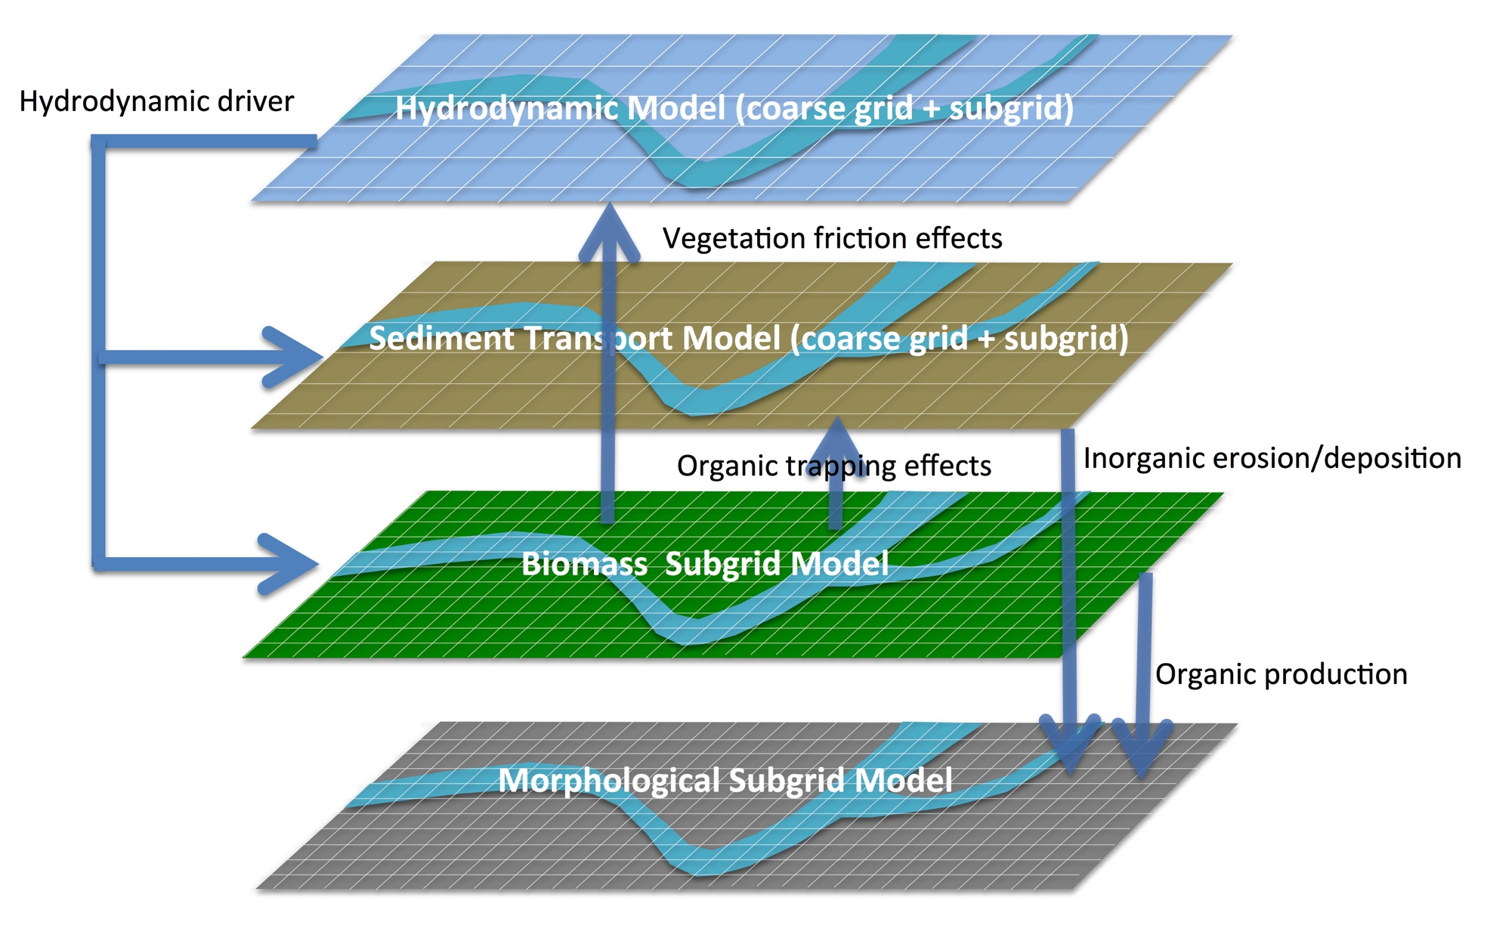
The hydrodynamic, biomass and sedimentation components are fully coupled in an efficient subgrid model framework in a parallelized computational environment.

Slide 2
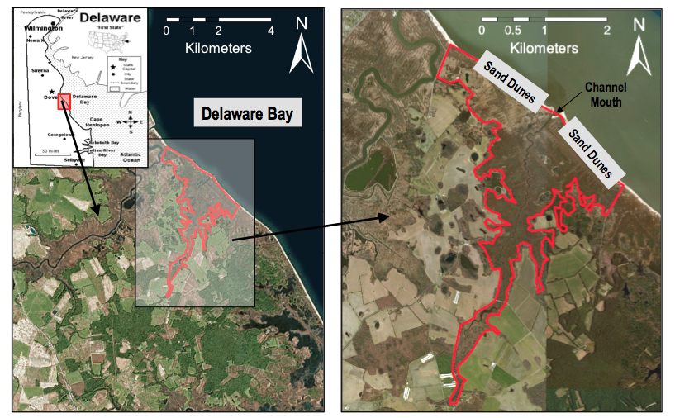
The study was conducted at Brockonbridge Marsh which is located about 38 km upstream from the mouth of Delaware Bay and covers an area of roughly 10 km²

Slide 3
The topography of Brockonbridge Marsh (a). Observation sites are marked with red dots. Sites A–F are located in the main channel, and Site G is in a tertiary channel. Detailed topography in the rectangle in a is shown in b, and detailed topography in the rectangle in b is shown in c. The grid lines in c indicate a coarse grid resolution of 8 m used for modeling.

Slide 4
Comparisons of simulated and measured water level time-series. The black solid lines represent the measurements, blue dot dashed lines represent Model A results, and red dot dashed lines represent Model B results, and dark green dot dashed lines represent Model C results

